Slide 1
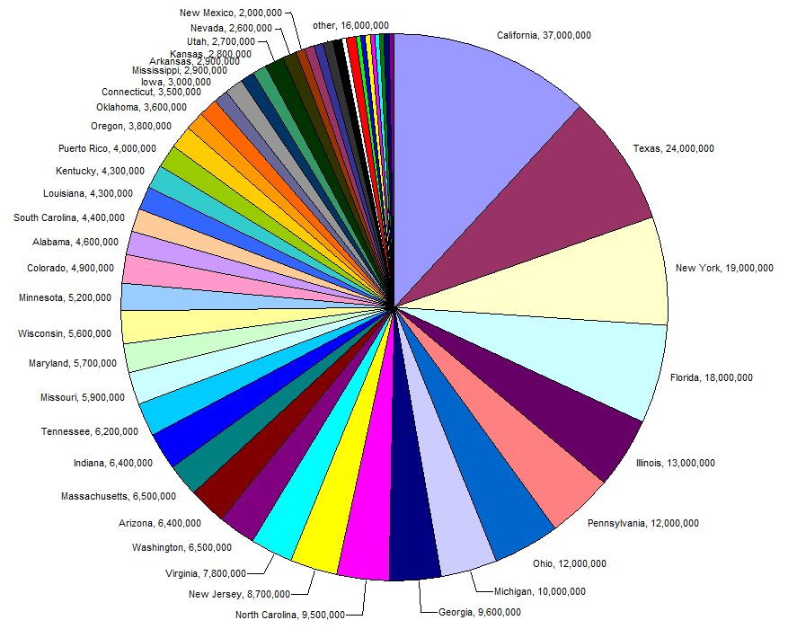
Supporting R&H Data Production
with Executive QC Dashboards
Shaun Perfect
Senior GIS Analyst
ADOT
John Ehlen
GIS Project Manager
Gistic Research, Inc

Slide 2
Agenda
Introductions
Background & Need
Dimensions and Metrics
Architecture
Challenges
Notes:
Importance of quality data

Slide 3
Challenges with large-scale data maintenance
Many of us can relate to data bugs and errors getting introduced in day-to-day editing activities especially using large datasets that consist of many different data layers.
Notes:
Importance of quality data

Slide 4
Why So Many Errors?
105 editable registered features
Many Editors
Multiple projects that all involve manual editing
Automated processes
ADOT’s 2014 Roads & Highways migration
New errors can be introduced in fixing existing errors
Notes:
ADOT’s Roads & Highways SDE consists of 105 registered features, many of which are edited and maintained on a daily basis
ADOT’s Roads & Highways data production and maintenance is handled by not only ADOT MPD and IT employees but also multiple outside consulting firms
Multiple projects are ongoing throughout the year that all involve manual editing (using tools) within the LRS and the supporting events - unification, hpms,
Automated processes are introduced with in-depth processing across events. Many rules need to be accounted for and thought out.
Many hard to find errors still exist across many events from ADOT’s 2014 Roads & Highways migration
In some cases, new errors are introduced in fixing existing errors

Slide 5
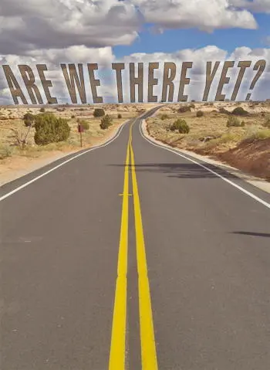
Using Pre-dated Software
ADOT MPD upgraded to ArcMap 10.7 last year
We have only recently implemented Data Reviewer
Have yet to implement Insights
Still need to upgrade Workflow Manager and initiate better, more concise workflows to assist in our daily processes
Waiting for full confidence in how Roads & Highways works with Pro
Notes:
Importance of quality data

Slide 6
The Need For More
GIS and project managers want to have quick feedback to see who and what type of errors are being made.
Dashboards that provide specific managerial tools to view errors were not previously available to ADOT
Having a checklist of errors with the types of errors and locations for GIS technicians/analysts to use while conducting data corrections would help efficiency
Notes:
Importance of quality data

Slide 7
ADOT Data Quality Control Process in RnH
Before Dashboard Development
Manual data quality control process only done when needed or when specific errors found
Data bugs proceed in data easily
No automated processes
No standard QC rules in place
Overlapping Events
Notes:
Before Dashboard Development
Data Manually QC’d
>>>
Data bugs proceed in data easily
>>>
No automated processes
>>>

Slide 8
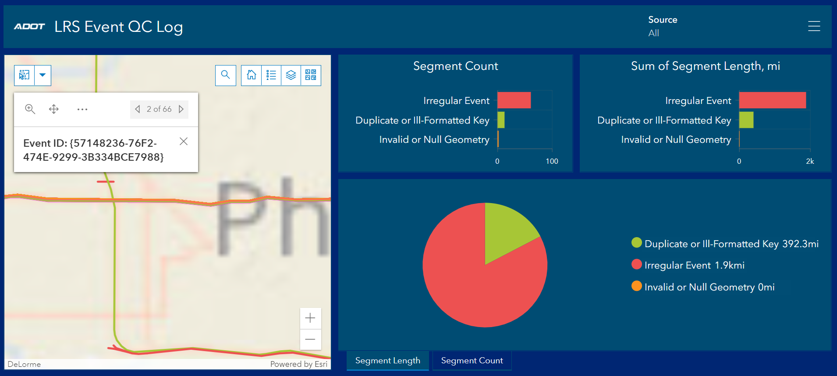
ADOT Data Quality Control Process in RnH
After Dashboard Development (Tableau)
Managers can review data bugs real time
Automated processes to find and catch data bugs
Prioritize data issues to tackle high order items
Transitioned from Tableau to Google Data Studio
Notes:
After Dashboard Development
Managers can review data bugs real time
>>>
Automated processes to find and catch data bugs
>>>
Prioritize data issues to tackle high order items
>>>

Slide 9
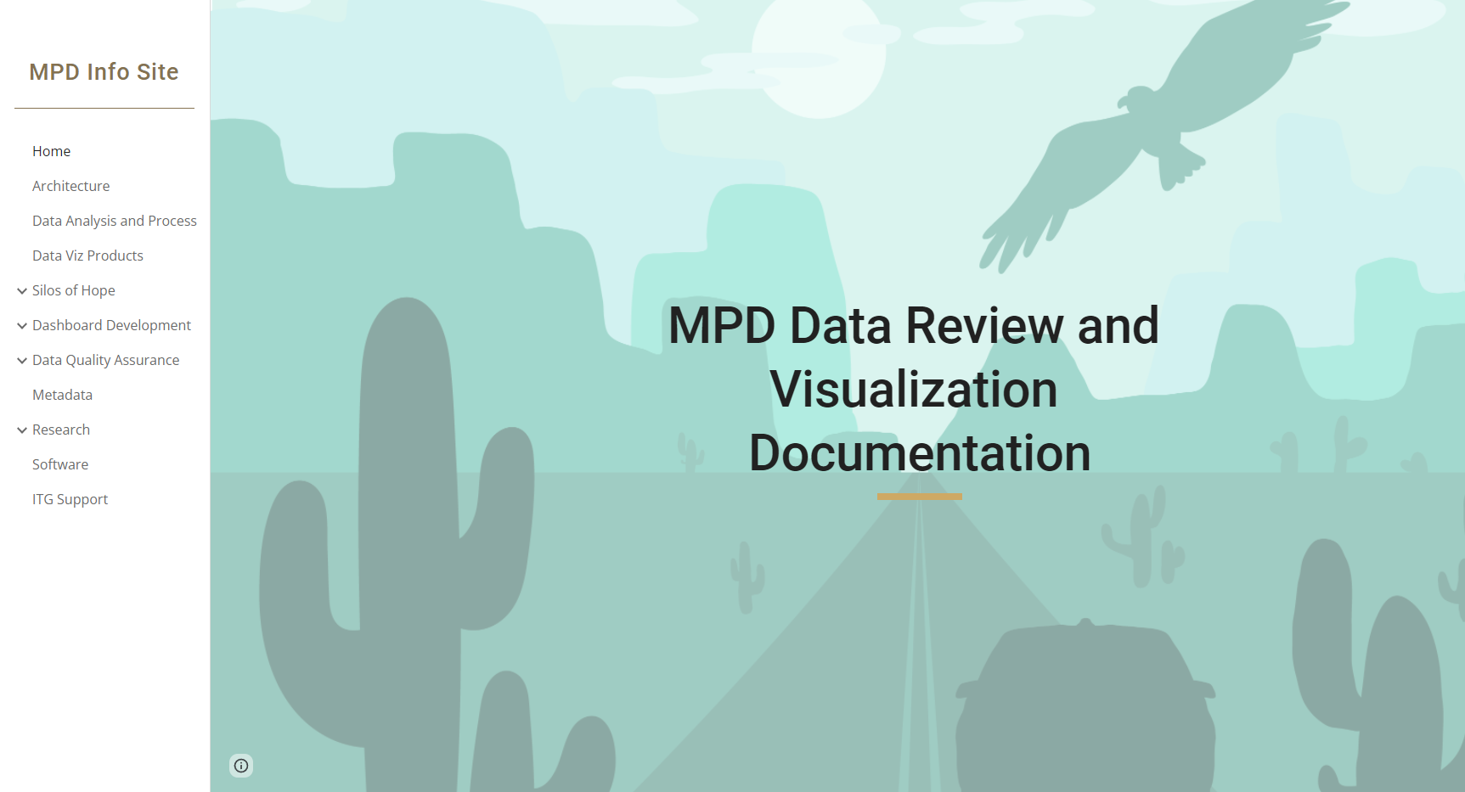
ADOT QC Rules Defined & Documented
As MPD GIS made its transition from using the Tableau dashboard to the Google Data Studio, we documented all QC rules and implementations as they were put together using Google Sites.

Slide 10
Dashboard Dimensions
Who
Editors / Editing Agency
When
Rolling 60 days (flexible)
Layers
All relevant features in SDE
Error Type (Displayed on separate tabs)
Domain Violations, LRS Event Errors, LRS Route Errors
Error Description
General description of the error to assist in resolution
Error Location
Along which route, and at what measure, and for which event is the issue located?
Error Specification
Object ID(s) of specific record showing error is given
Notes:
Dimension specifics can be changed and added to

Slide 11
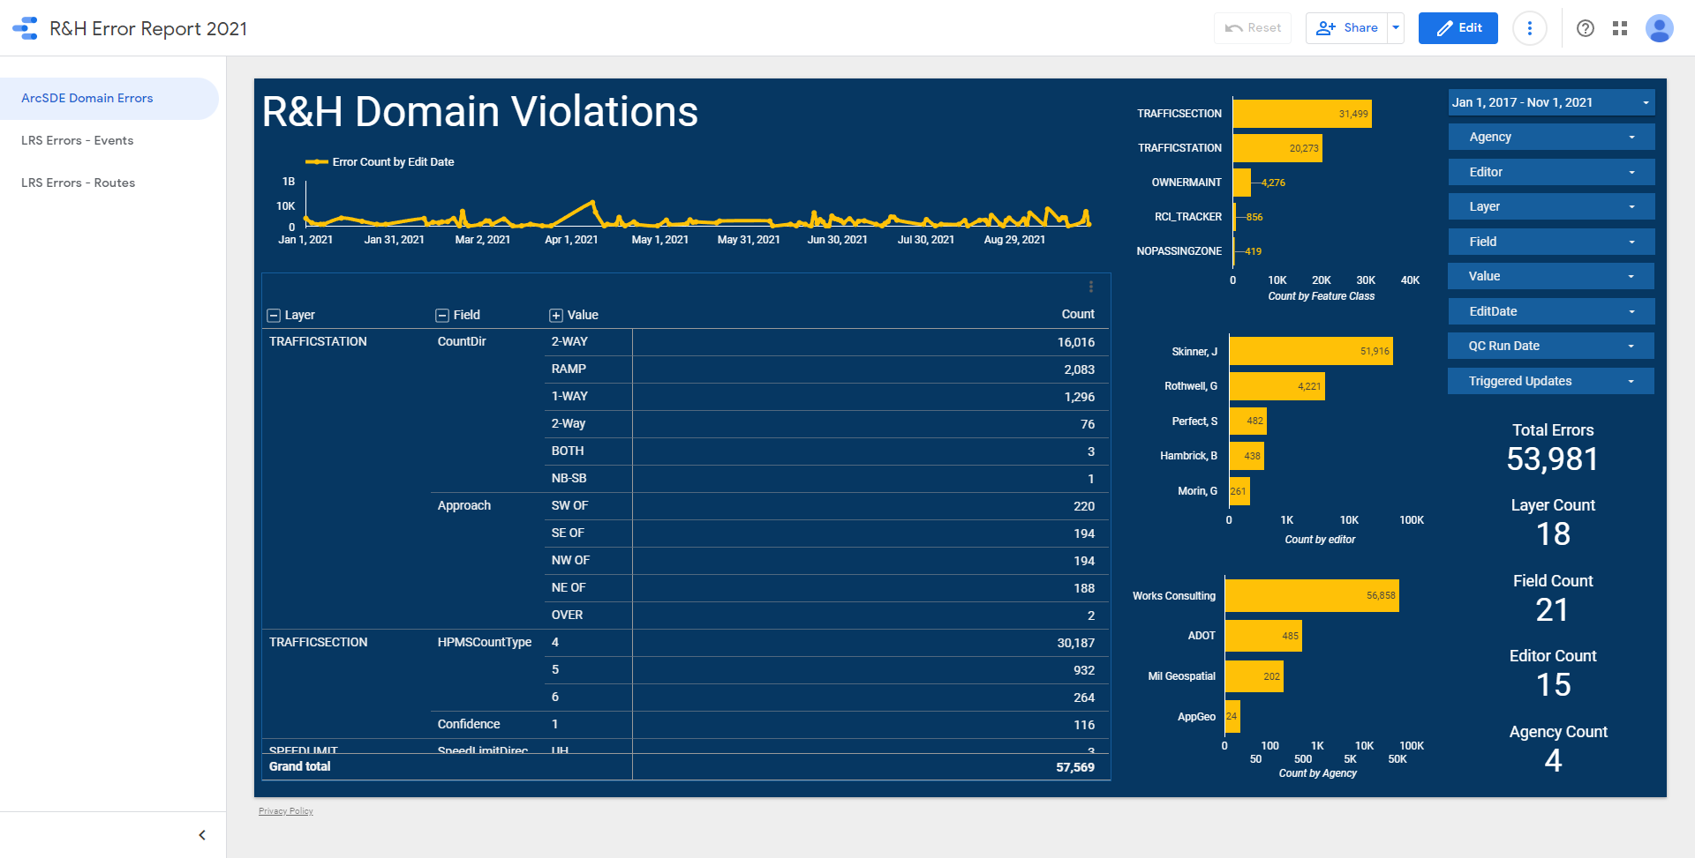
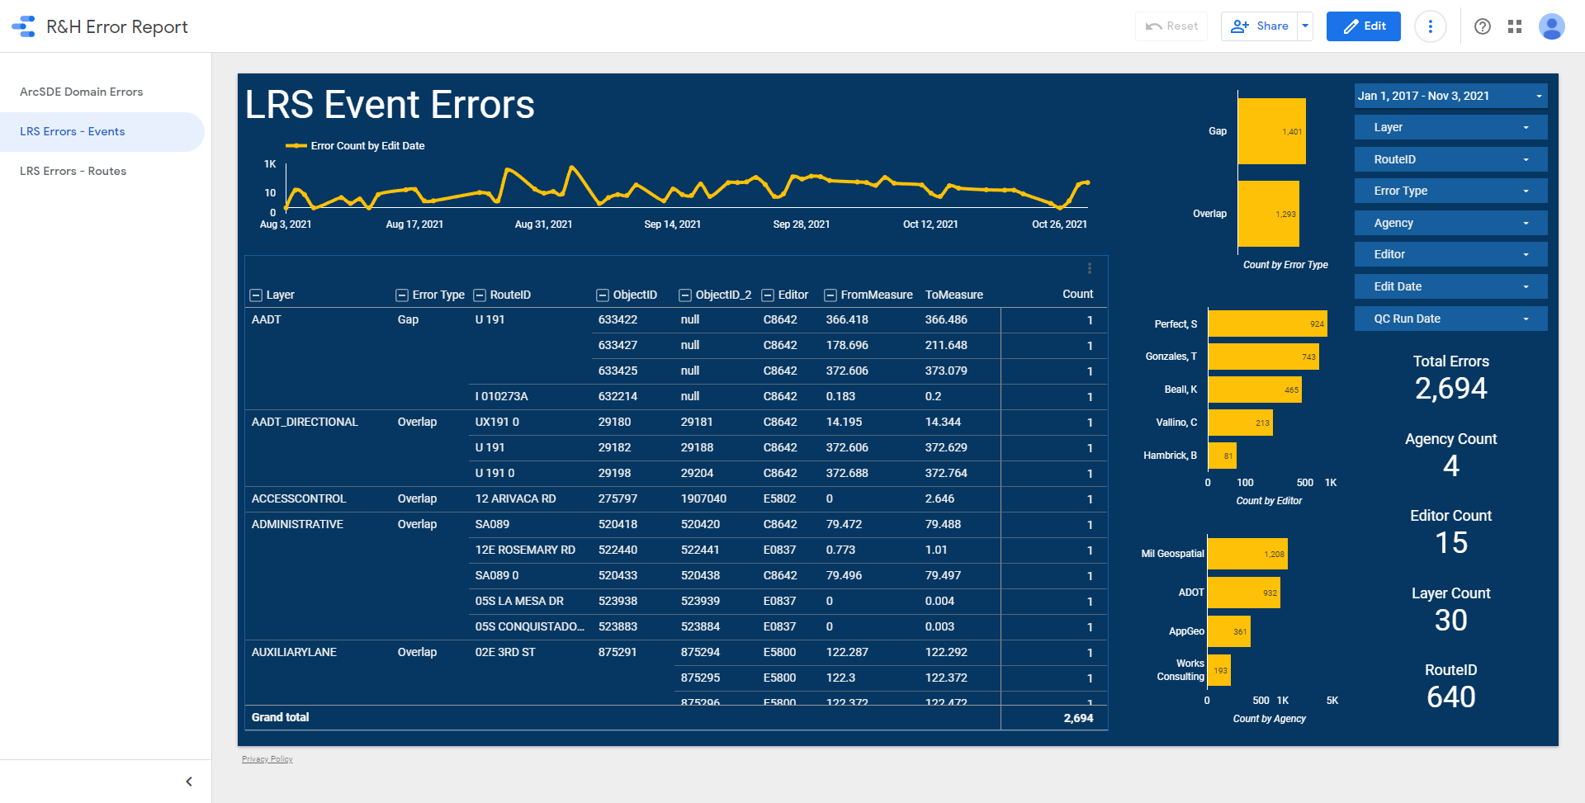
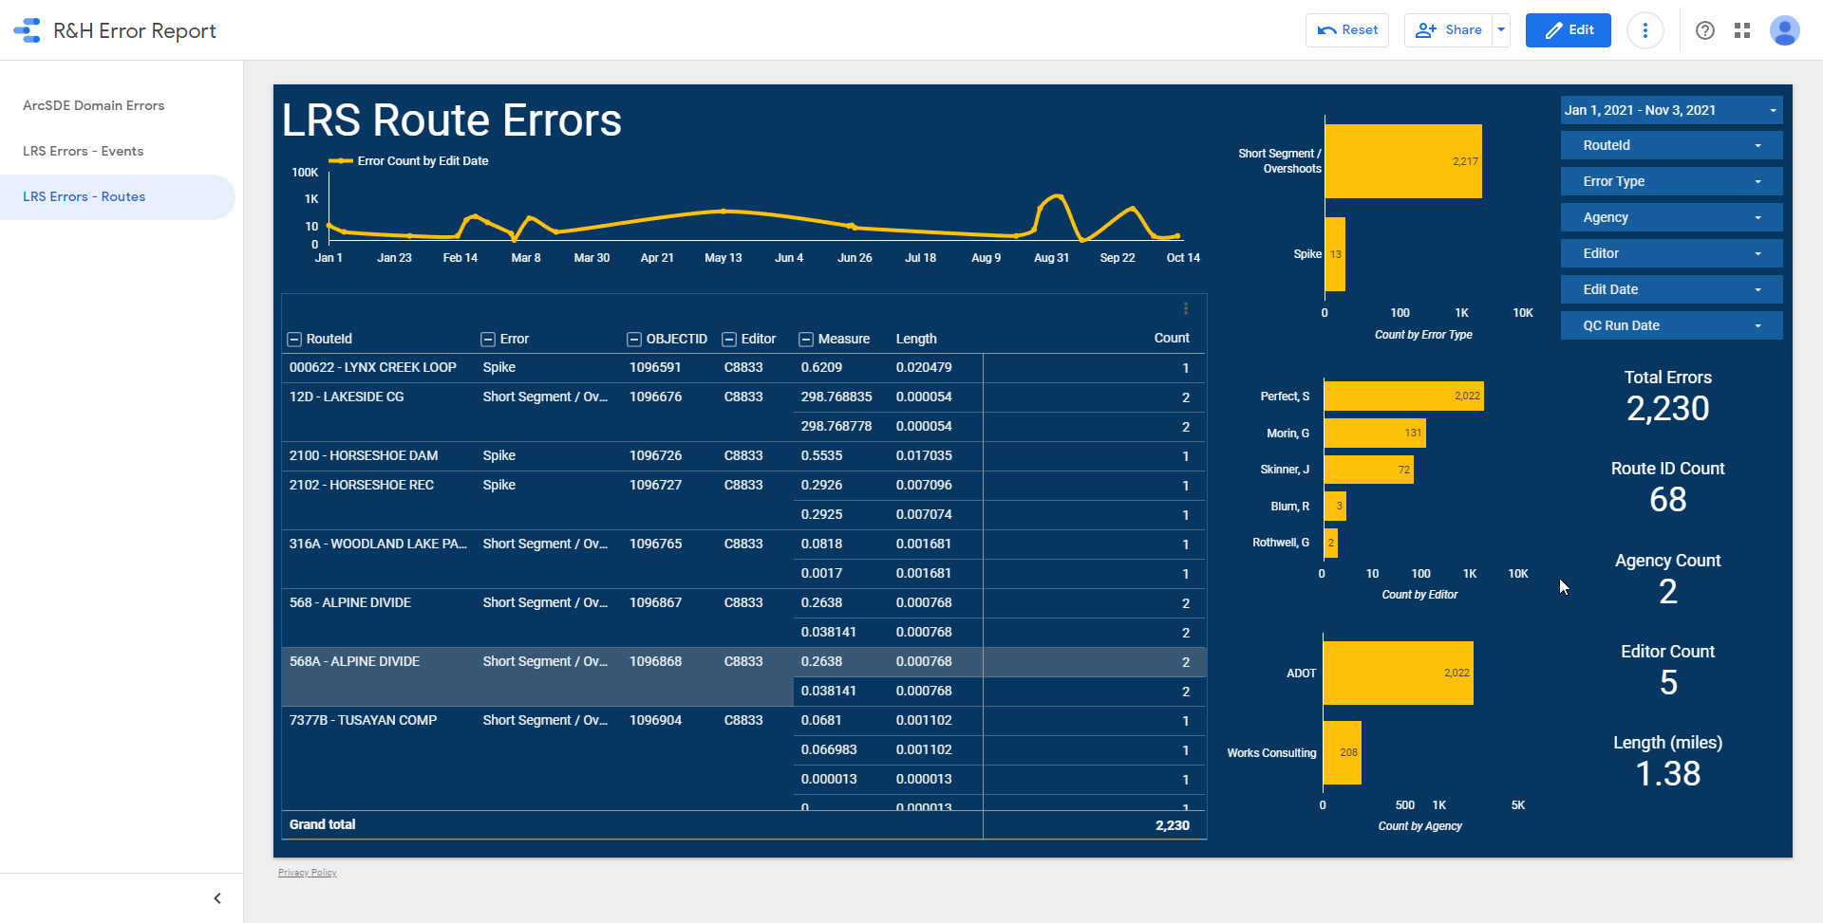
R&H LRS Quality Control Dashboard
Notes:
Shaun, thanks for providing the background and introduction from ADOT’s side of things. Now, before we jump into the design and architecture, let’s take a brief look at the finished product.
>>
The dashboard contains 3 tabs. One for domain errors, one for event errors, and one for route errors. Here we can see the Domain Errors Tab.
>>
Here we have the event errors tab. Notice, all criteria Shaun and the ADOT Staff have identified have been accounted for including: Who made the edit, when the edit was made, was layer was affected, What the type of error is, a description of that error, and where that error occurred on the route system.
>>
Finally we have our route QC tab, where geometrical errors along the route system are shown.
Now that you’ve got a general sense of what we’re talking about, I’m going to dive into the how this dashboard is built, and how the GISTIC team collaborates with ADOT to allow them to define QC parameters in real time.

Slide 12
QC Categories
ArcSDE Domain Violations
All domain controlled layers/fields minus pre-determined exclusion list
LRS Event Errors
Gaps, Overlaps, Out-Of-Bound events
LRS Route Network Errors
Undershoots, Overshoots, Spikes, Overlaps, etc
Triggered Updates
Error resulting from route edit propagating to event
Notes:
First, we grouped the LRS system into categories, based on their relation to each other and the intended QC checks. We identified 3 categories we wanted to report on, attribute domain violations within the ArcSDE Database, LRS Event Errors, and the LRS Route Network itself.
Additionally, we discovered the need to be able to identify if an edit on an event was triggered by an edit to the associated route, or if the edit was a manual edit done by an editor. We call these “triggered updates”.

Slide 13
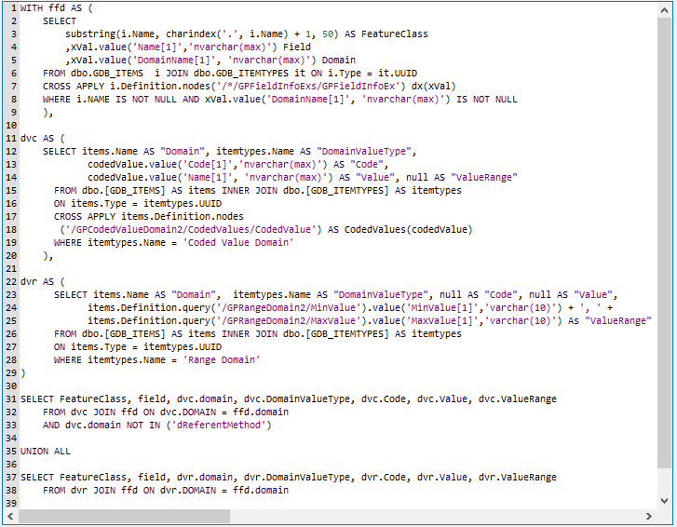
QC Category - Domain
Notes:
Looking at the first QC Category, Domain Violations, We opted to take a somewhat different approach than normal. Traditionally, one would imagine that you would start with either a feature class, or domain to verify.
In our case, we actually query the xml domain definitions to obtain a list of EVERY domain controlled feature class, as well as every field controlled by domains in that feature class, and what the valid values for that field are.
>>
Next we use direct sql queries against the default view tables to read the current state of the records. Using direct sql to read is much more performant and allows us to only read in the domain controlled fields as well as ignoring geometry, leading to faster processing time
>>
Finally we compare the current value of each field against it’s authoritative list of values as found in the domain and report on violations.
>>

Slide 14
QC Category - Events
Notes:
In terms of our next category, Event Errors, we classified them into 4 different error types.
The first type is a coverage gap, where an event should have coverage for the full length of a route but is missing in some areas.
>>
The next type of error is extent, where the event actually exists beyond the extent of the route
>>
The next error is overlaps, and occurs where two distinct events that should not overlap exist in the same spatial location
The 4th error, not shown here, is events that have been tied to non existent (or retired and not replaced) routes.

Slide 15
QC Category - Routes
Geometry Errors
Invalid, empty, degenerate, etc.
Route Measure Inconsistencies
Monotonicity - one spatial location corresponds to one unique measure, and each unique measure corresponds to one spatial location.
Route Vertex Inconsistencies
Geometry contains short segments, points, minor gaps, undershoots, overshoots, or a switchbacks.
Notes:
Finally, we have our route errors. These route errors themselves are actually broken up into 3 separate categories which we will briefly investigate. These categories are:
Geometry Errors, where we Invalid, empty, degenerate, corrupt, and null geometries
Route Measure inconsistencies where measure/vertex location violates the idea that one spatial location should correspond to one unique measure, and each unique measure corresponds to one spatial location.
Vertex inconsistencies, where Geometry contains short segments, points, minor gaps, undershoots, overshoots, or a switchbacks. Typically caused by snapping errors.

Slide 16
QC Category - Route Geometry
Notes:
In terms of the first category, it is a simple spatial validity check, looking for things like Invalid, empty, degenerate, corrupt, and null geometries, as well as where our geometry contains Not-a-number, infinity, and negative infinity geometries

Slide 17
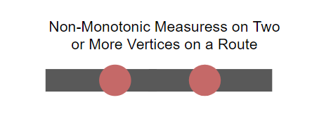
QC Category - Route Measure
0
0
0.68
0.8
0.68
0.4
1
1
Same measure, different location
Decreasing vertex measure, but increasing route measure
Notes:
The next category, route measure, ensures the monotonicity of the route measures and vertex locations. In this first example, we can see that distinct two locations share the same measure.
>>
In our next example, we can see we have decreasing measures along the increasing direction of roadway

Slide 18
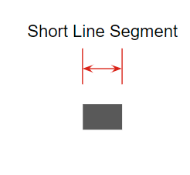
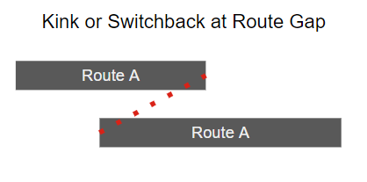
QC Category - Route Vertex
Undershoot
Overshoot
Route A
Route A
5ft
Route A
Small Gap
Notes:
Finally, we have our route vertex errors. These include numerous checks, only a few of which I will discuss here
>>The first is our undershoot category, where a line doesn’t fully connect to the rest of the network leading to a disconnectivity among segments.
>> Next, we have the invernse, where the segment expands just past the route it should intersect. Both these errors are usually the result of improper or disabled snapping.
>>Next we have our short line segments. This is a configurable check, and we have decided any pavement segment shorter than 5 feet is invalid.
>> Next we have out small gaps, where a gap exists in the route. When we say small, we mean small. Sometimes these values could be a fraction of an inch or foot.
>>Finally, we have our switchbacks or kinks, where the route is offset and slightly behind the previous segment. Similar to the short gaps, these kinks and switchbacks can be miniscule in scale and difficult to detect with just the eye.

Slide 19
Dashboards Options:
Tableau vs AGOL VS Google Data Studio
Tableau:
Pros:
Can do OTF calculations
Can create calculated fields
Much easier to work with tabular data
Easier to accommodate landing page, disclaimer
Cons:
Can be cumbersome to develop and maintain
ADOT Internal network required for viewing
AGOL:
Pros:
Great w/ spatial data viewing and analysis
Can be viewed outside ADOT network
Cons:
Limited Tabular Visualization
No OTF calculations
No calculated fields
Hard to fully replicate tableau
Google Data Studio:
Pros:
Can replicate most Tableau functions
Can be viewed outside ADOT Network
Cons:
Manual workflow to update data
Can’t publicly be viewed without ADOT log in
Cell count limitations for google sheets
No Mapping Capabilities
Notes:
So now that we know what our objective is and how we intend to classify everything, how did we decide on a platform and actually go about building this? Well, at the time of the dashboards inception, most of the dashboards ADOT used were built with Tableau.
>>
While Tableau is an incredibly powerful data visualization tool, it suffered the critical flaw of being limited to the ADOT Intranet and was unavailable for use outside the ADOT firewall. This presented a huge problem for the ADOT managers and staff who were forced to work remotely, while at the same time presenting the team at Gistic with an exciting opportunity to investigate the potential substitutes to Tableau.
We limited our analysis to technologies that were (1) accessible outside of the ADOT intranet, and (2) already in use by ADOT. These criteria meant we could begin testing and development with no budget considerations or delays due to software acquisition. Within this scope, we identified two additional dashboarding platforms at our disposal:
>>
ArcGIS Online and Google Data Studio. Ultimately, since this dashboard was intended for tabular visualization and not spatial visualization, it was determined that the best approach would be utilize the powerful tabular visualization capabilities offered in Google Data Studio that are missing from ArcGIS Online.
Additionally, we knew we had access to FME Desktop. This allowed us to take advantage of where each platform truly shines: Orchestrating data translation and migration using FME, and the powerful tabular capabilities of Google Data Studio. The blending of these two technologies was instrumental in the success of this project.

Slide 20
Data
Flow
Domain Errors
Event Errors
Route Errors
Google Drive
RH QC Dashboard Data Sources
Google Drive
Master QC Table
Roads & Highways
ADOT ArcGIS SDE SQL SERVER
FME Workspaces
FME
Google Esri
Custom LRS Transformers
Notes:
The process overview, at its simplest, involves:
>>
Using a series of FME workspaces to read recently edited records from the ADOT ArcGIS Roads and highways Database
>>
Processing those edited records in FME using a series of custom FME transformers as well as user-parameters retrieved from a google sheets document owned by adot
>>
Using FME to push the QC results to a series of tabs inside one Google Sheet in the ADOT Google Drive Account
>>
And then using This google sheet as the data source for the various widgets and report elements in the google data studio report. The google data studio report, whose elements are shown in the black dashed outline, is used by managers to evaluate internal workflows, diagnose process gaps, and identify editors who may be in need of further training. For instance, if one editor makes the same mistake multiple weeks in a row, it is likely a training/process issue that should be addressed.

Slide 21
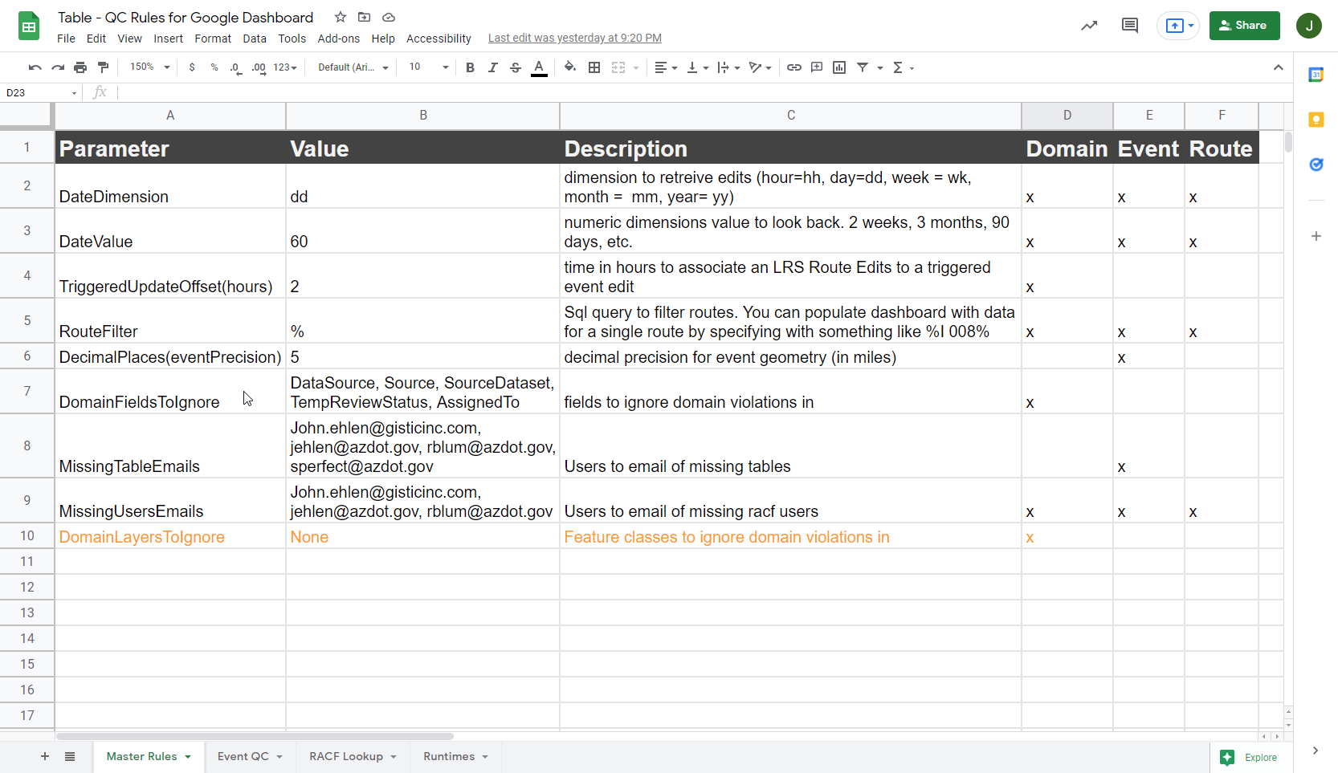
Dynamic Parameters
Google Drive
Event QC Rules
Notes:
Another challenge we faced with this project was making it flexible and configurable enough to meet the ever-changing needs at ADOT. Additionally, even though these dashboard processes at use FME, no one at ADOT knows how to use FME.
This means that when ADOT staff decide the dashboard should query data 3 months back instead of 2, or that the decimal precision for events should change from 5 to 6, they needed to email us and request the changes. We then had to log into the ADOT VPN, access a machine, open FME change the parameters, save the workspace, and re-run the process.
To remedy this, I created a system where the workspace parameters are actually derived from a Shared Google Sheet. This allows the ADOT staff to make changes to the workspace directly without having to open FME. Once a change is made in the sheet, those updated parameters will be used to run the workspace at its next schedule run time.
In this image, you can see the shared parameters used across the various workspaces, with columns identifying which of the three error categories the parameter is used in.

Slide 22
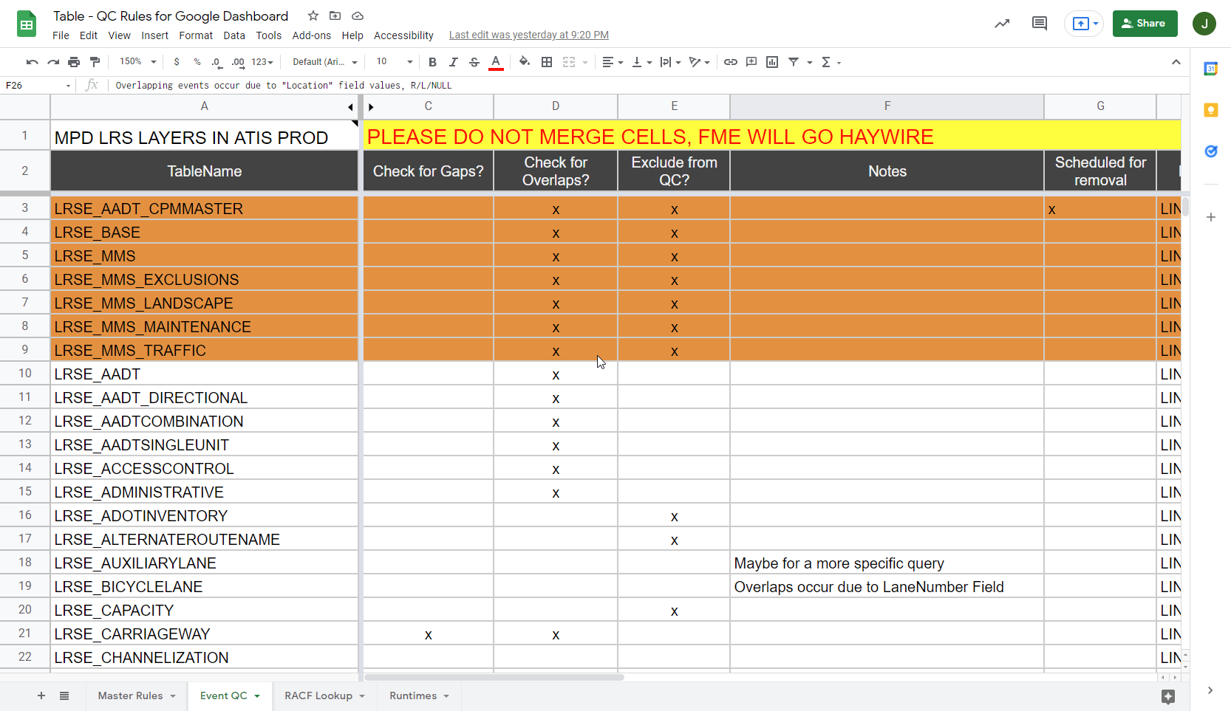
Dynamic Parameters
Google Drive
Event QC Rules
Notes:
In addition to the previously mentioned challenges, ADOT is currently in the process of refining their database and many feature classes are scheduled for removal, while some feature classes have yet to be created and/or registered in the database. This means we have an ever changing table set in the database, and we need a way to determine what QC rules should apply to what Event Layers. Some events allow gaps, while others allow overlaps. However, all events should be checked for extent to ensure they are within the boundaries of the associated route.
This table in the screenshot shown here, allows us to dynamically determine at runtime which QC checks should be enforced. Similar to the parameter shown on the last slide, any updates made here will be reflected in the next automated run of the process.

Slide 23
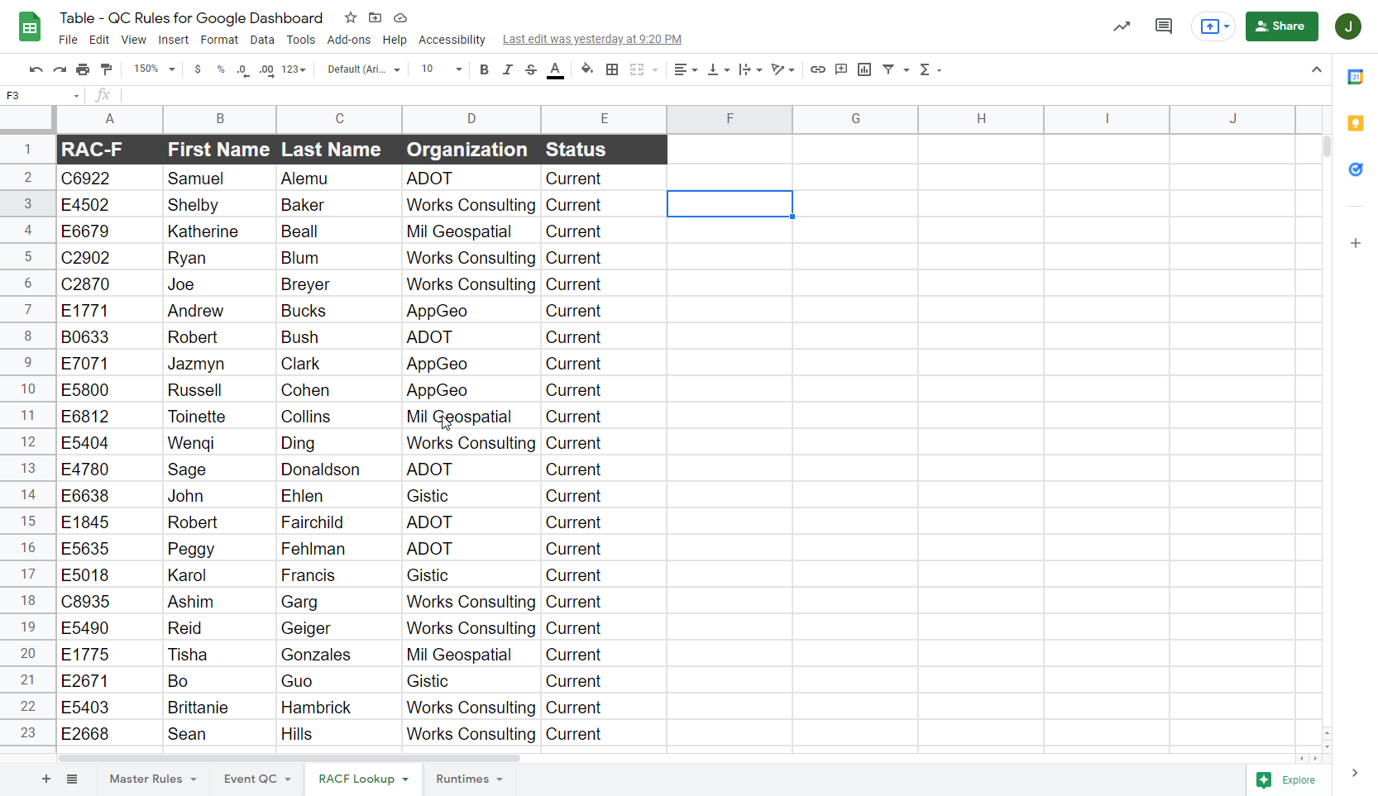
Dynamic Parameters
Google Drive
Event QC Rules
Notes:
The last part of the dynamic parameters relates to editors. In this sheet here we can see a list of all GIS editors, including the UserID, First and Last Names, Organizations, and work status.

Slide 24
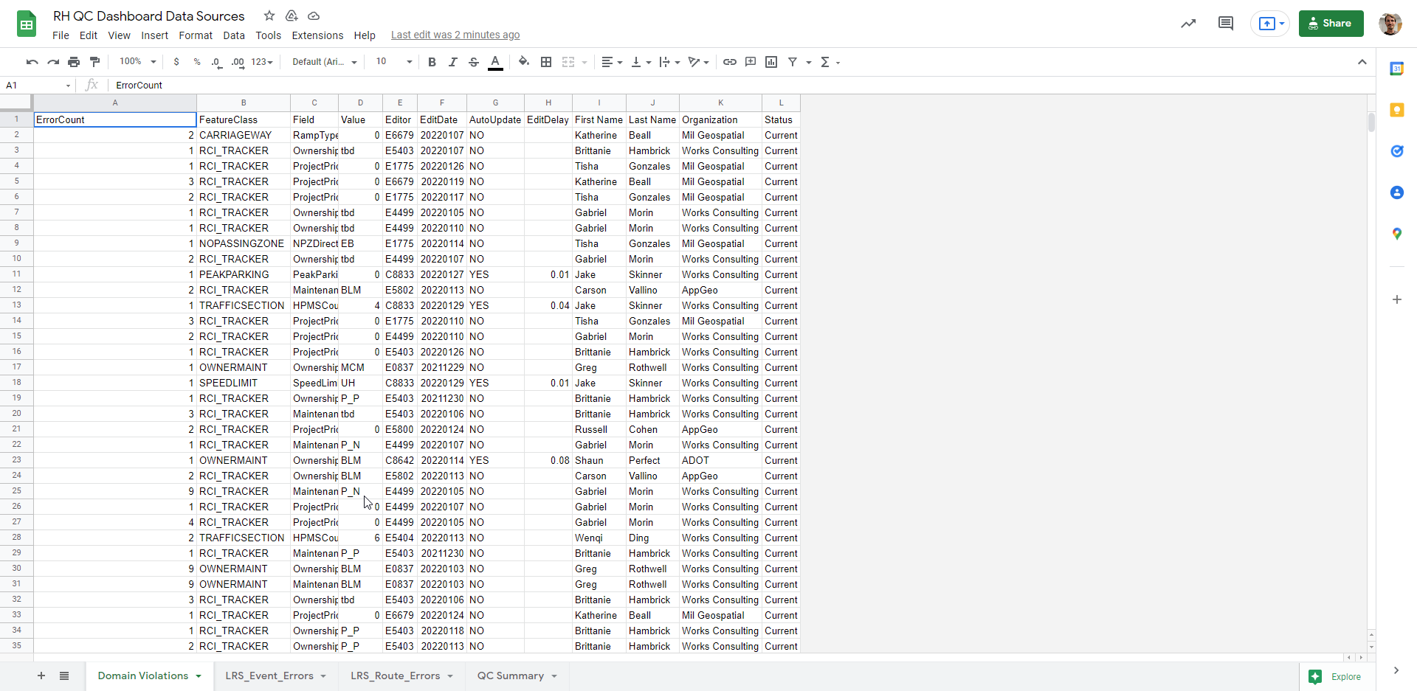
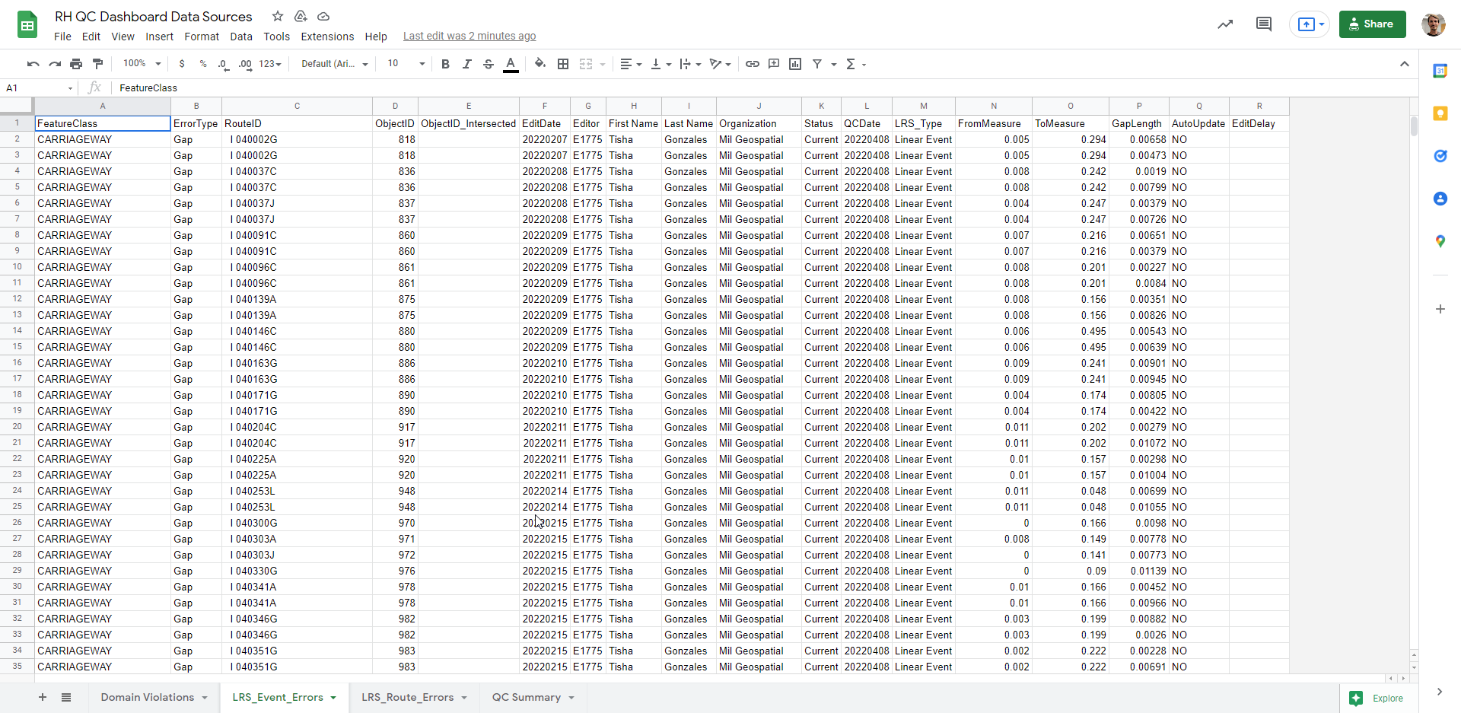
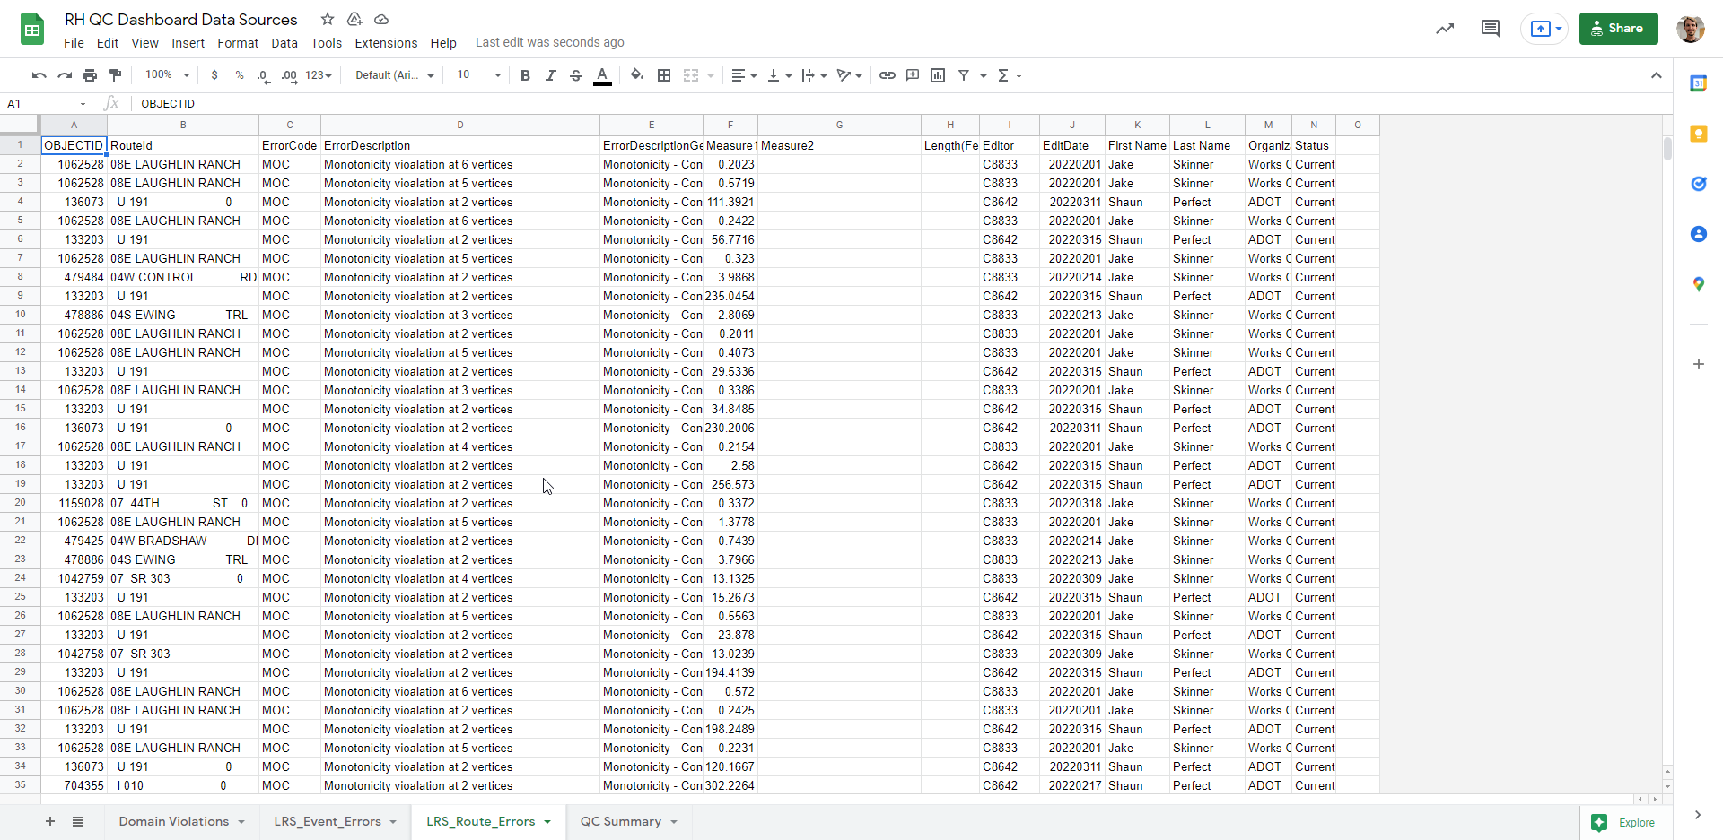
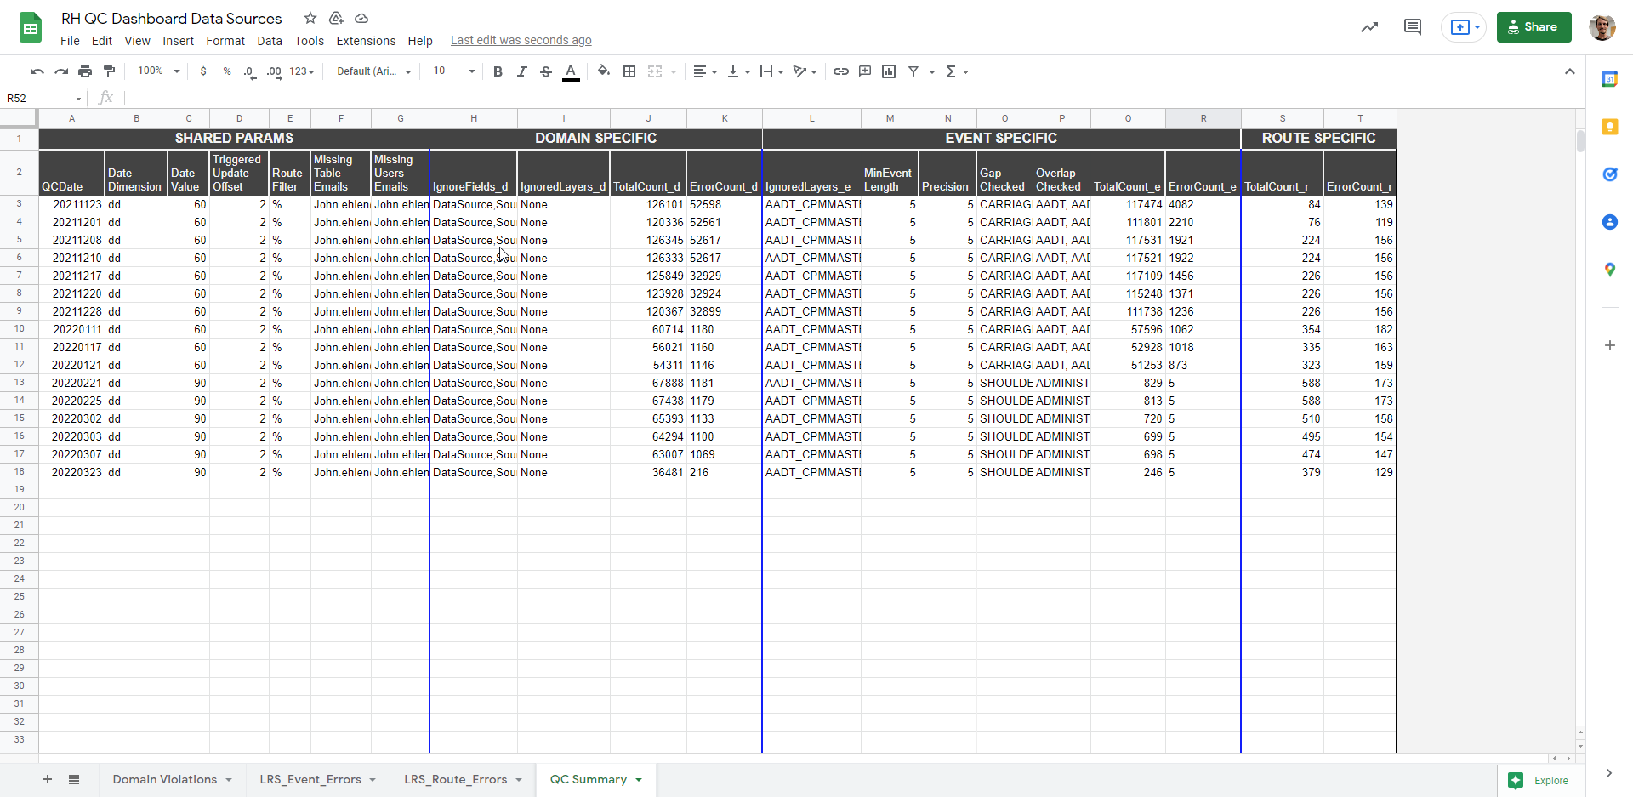
Data
Store
Google Drive
RH QC Dashboard Data Sources
Notes:
Finally, we’ve reached the output of the FME Processes: This is the google sheet that contains the results of the FME processes and is what powers the Google Data Studio Dashboard. The sheet contains multiple tabs:
>>
a summary tab where the overall results are logged for each run,
>>
A tab for domain errors
>>
A tab for event errors
>>
And a tab for route errors

Slide 25
Future Evolution…?
Data Reviewer
Roads and Highways
FME
Roads and Highways
FME
ArcGIS Online?

Slide 26
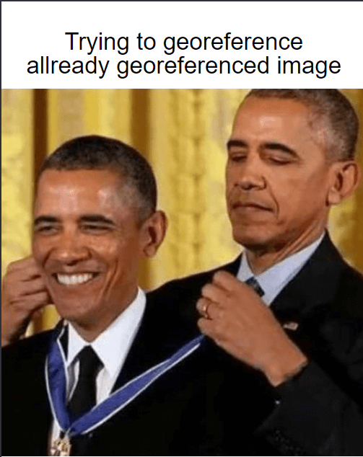
Trying to georeference an already georeferenced image
Questions?

Slide 27
Contact Info
Shaun Perfect
sperfect@azdot.gov
https://www.linkedin.com/in/shaun-perfect/
John Ehlen
john.ehlen@gisticinc.com
www.linkedin.com/in/johnjehlen

